Slide 1
IMPLEMENTATION OF LL(1) & SLR(1) PARSER

Slide 2
TEAM MEMBERS
ABHIRAM PRASAD
NITHIN SYLESH
AM.EN.U4AIE19001
AM.EN.U4AIE19044
RITIKA R PRASAD
AM.EN.U4AIE19053
VYSAKH S NAIR
LAKSHMI G PILLAI
AM.EN.U4AIE19072
AM.EN.U4AIE19074

Slide 3
Table of Contents
01
Introduction
04
Methodology
02
05
Implementation
Prerequisite Knowledge
03
Theory
06
Reference

Slide 4
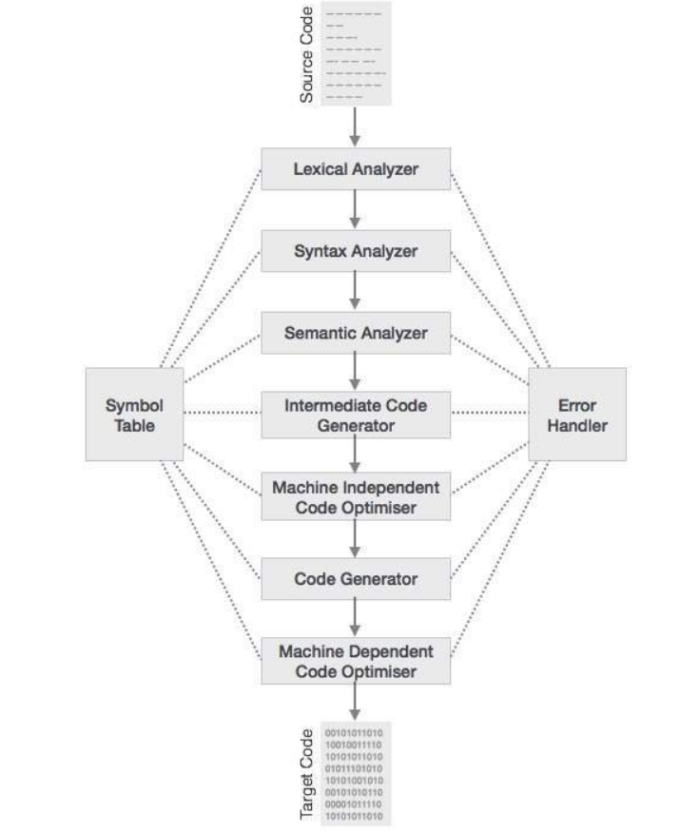
Introduction
Compiler Design is the structure and set of principles that guide the translation, analysis, and optimization process of a compiler.
The compilation process is divided into several stages. Each phase receives data from the previous phase, creates its own representation of the source programme, and feeds its output to the compiler's next phase.
In this project we have implemented LL(1) and SLR(1) parser

Slide 5
Prerequisite Knowledge
A parser is a component of a compiler or interpreter that divides data into smaller chunks for easier translation into another language.
There are 2 types of parsers
Top Down Parser
Top-down parsing tries to find the input string's leftmost derivations.
In this top-down parsing technique, we start at the top (start symbol of parse tree) and work our way down (leaf node of parse tree).
Bottom Up Parser
Bottom-up parsing is an attempt to reduce the input string to the grammar's start symbol.
In this bottom-up parsing technique, we start parsing from the bottom (the leaf node of the parse tree) and work our way up (the start symbol of the parse tree).
In this project we chose to implement 1 each from both type of parsers, ie LL(1) from top down parsing and SLR(1) from bottom up parsing

Slide 6
Theory
LL(1) parsing is a top-down parsing method in the syntax analysis phase of compiler design. Input string, stack, parsing table for given grammar, and parser are all required components for LL(1) parsing.
G is the letter G. (V, T, S, P)
Simple LR Parsing is referred to as SLR (1). It's the same as parsing with LR(0). The parsing table is the only difference. We use a canonical collection of LR (0) items to build the SLR (1) parsing table.The reduce move is only placed in the follow of the left hand side in the SLR (1) parsing.

Slide 7
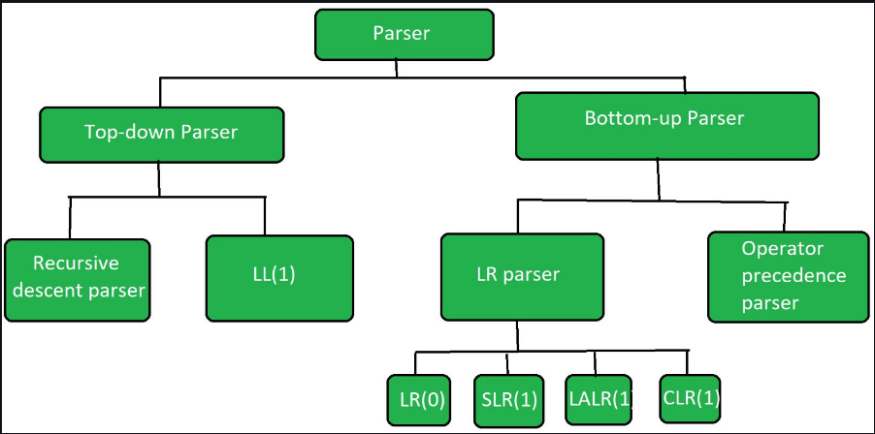
TYPES OF PARSERS

Slide 8
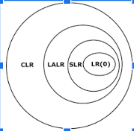
Types of LR parsing methods
Canonical LR parser
SLR(1)
CLR
LALR
Simple LR parser
Lookahead LR Parser

Slide 9
METHODOLOGY
4

Slide 10
LL(1) PARSER
Step 1: First check for left recursion in the grammar, if there is left recursion in the grammar remove that
Step 2: Calculate First() and Follow() for all non-terminals.
First(): If there is a variable, and from that variable, if we try to drive all the strings then the beginning Terminal Symbol is called the First.
Follow(): What is the Terminal Symbol which follows a variable in the process of derivation.
Step 3: For each production A –> α. (A tends to alpha)
Find First(α) and for each terminal in First(α), make entry A –> α in the table.If First(α) contains ε (epsilon) as terminal than, find the Follow(A) and for each terminal in Follow(A), make entry A –> α in the table.
If the First(α) contains ε and Follow(A) contains $ as terminal, then make entry A –> α in the table for the $.

Slide 11
SLR(1) PARSER
Construct C = { I0, I1, ……. In}, the collection of sets of LR(0) items for G’
If [ A -> ?.a? ] is in Ii and GOTO(Ii , a) = Ij , then set ACTION[i, a] to “shift j”. Here a must be terminal.
If [A -> ?.] is in Ii, then set ACTION[i, a] to “reduce A -> ?” for all a in FOLLOW(A); here A may not be S’
.
Is [S -> S.] is in Ii, then set action[i, $] to “accept”. If any conflicting actions are generated by the above rules we say that the grammar is not SLR.
The goto transitions for state i are constructed for all nonterminals A using the rule:
if GOTO( Ii , A ) = Ij then GOTO [i, A] = j.
All entries not defined by rules 2 and 3 are made error.

Slide 12
IMPLEMENTATION (in python)
5

Slide 13
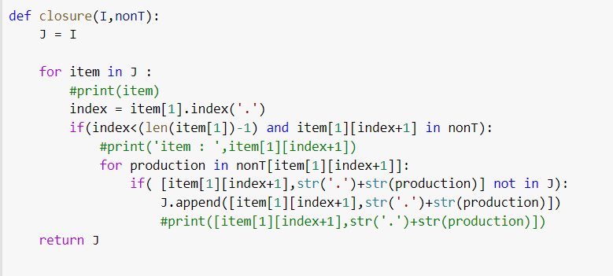
SLR

Slide 14
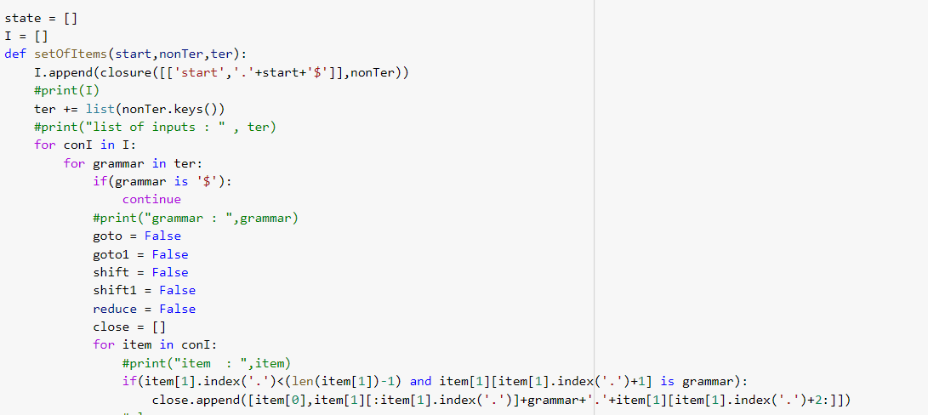

Slide 15
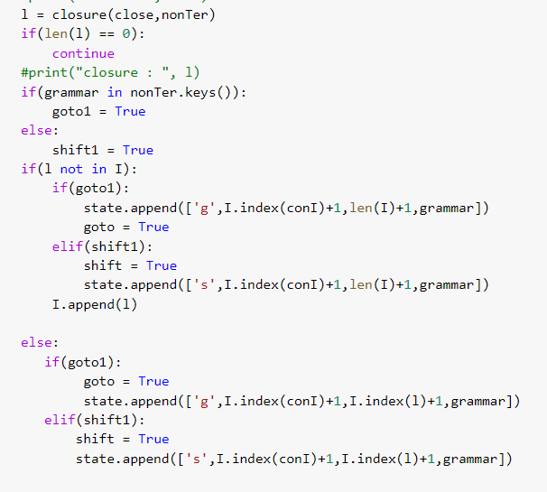

Slide 16
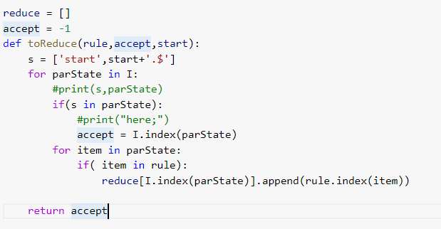

Slide 17
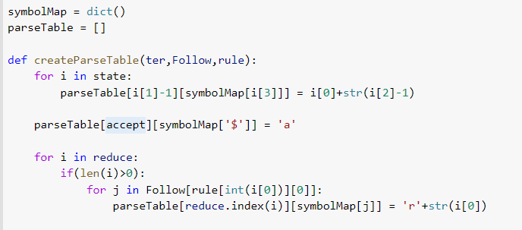

Slide 18
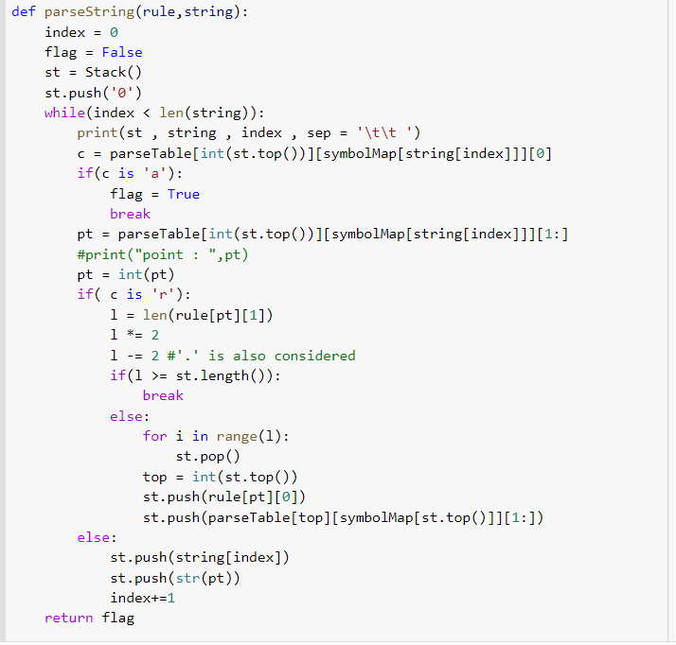

Slide 19
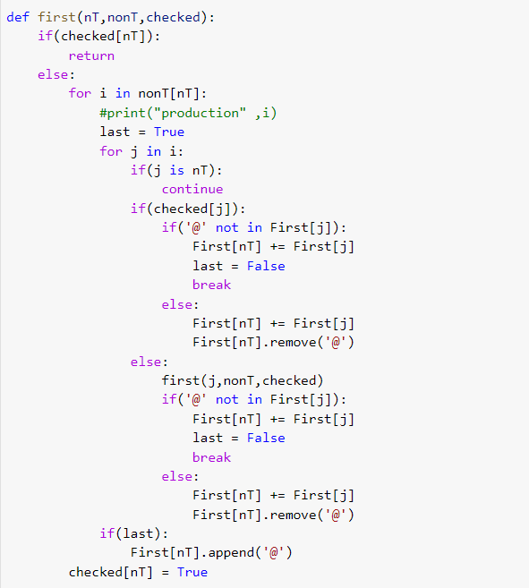
LL(1) PARSER

Slide 20
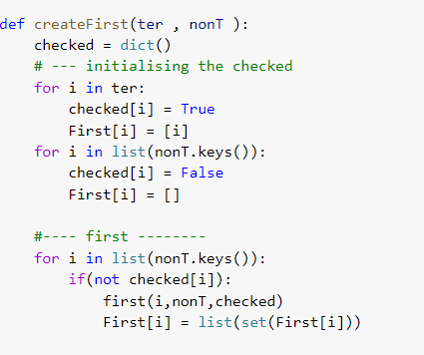

Slide 21
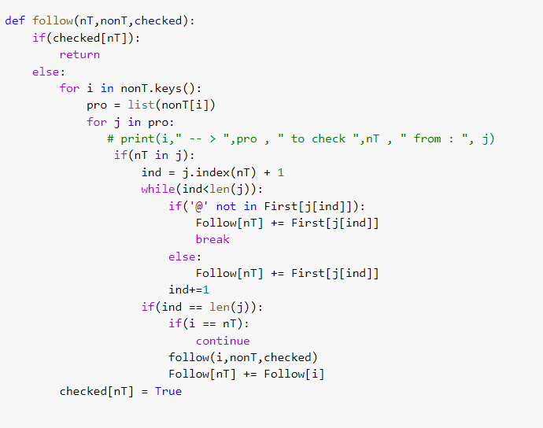

Slide 22
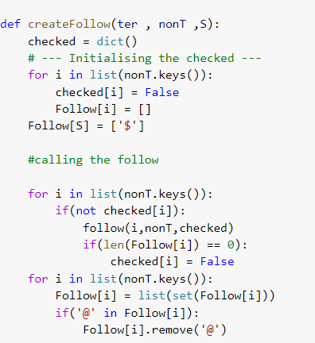

Slide 23
Conclusions
We have successfully implemented SLR(1) parser and LL(1) parser. We passed many different test cases through our models and have got the desired results . All the errors we found out have been successfully rectified.

Slide 24
REFERENCES
https://www.researchgate.net/publication/2744031_The_essence_of_LR_parsingr
https://www.researchgate.net/publication/221002100_IELR1_Practical_LR1_parser_tables_for_non-LR1_grammars_with_conflict_resolution
https://www.sciencedirect.com/science/article/abs/pii/S1477842409000037
https://link.springer.com/chapter/10.1007/978-1-4302-4597-1_14
https://dl.acm.org/doi/abs/10.1145/820127.820170
https://www.sciencedirect.com/science/article/pii/S0743106696000763

Slide 25


